Slide 1
Module 6: Modern Deep Learning Architectures - Part 3
Fall 2025

Slide 2
Outline
Generative Adversarial Networks (GAN)
Wasserstein GAN with Gradient Penalty
Conditional GAN
CycleGAN
Class Activity - GAN

Slide 3
Generative Adversarial Networks (GAN)

Slide 4
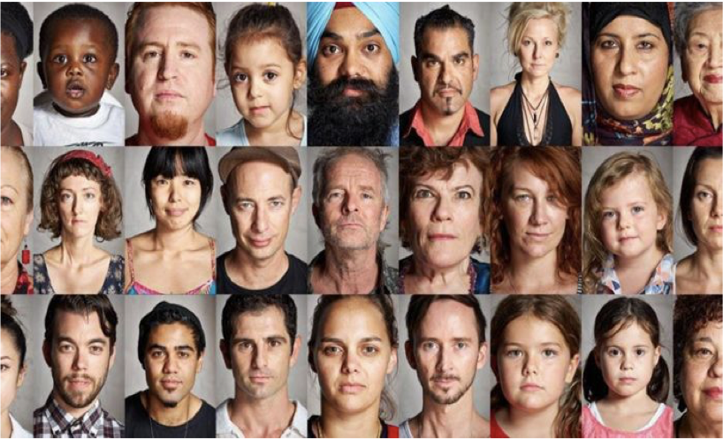
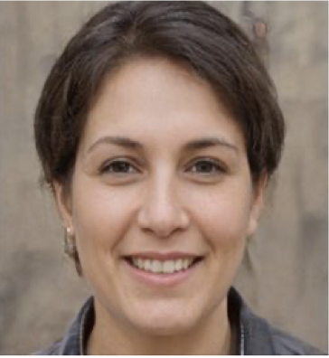
The Problem
From a large collection of images, can a network learn to generate a new image?
Generate samples from the distribution of “face” images

Slide 5
The Problem
From a large collection of images, can a network learn to generate a new image?
What do we want from a generative model?
We want an output that looks like it came from our dataset, but how do we judge that directly?
For high dimensional data, this can be really hard:
We often don’t have enough data to estimate the actual distribution of things
We often don’t have enough compute to see if our model is outputting according to said distribution
Solution: Have another network try and judge how realistic our outputs are for us

Slide 6
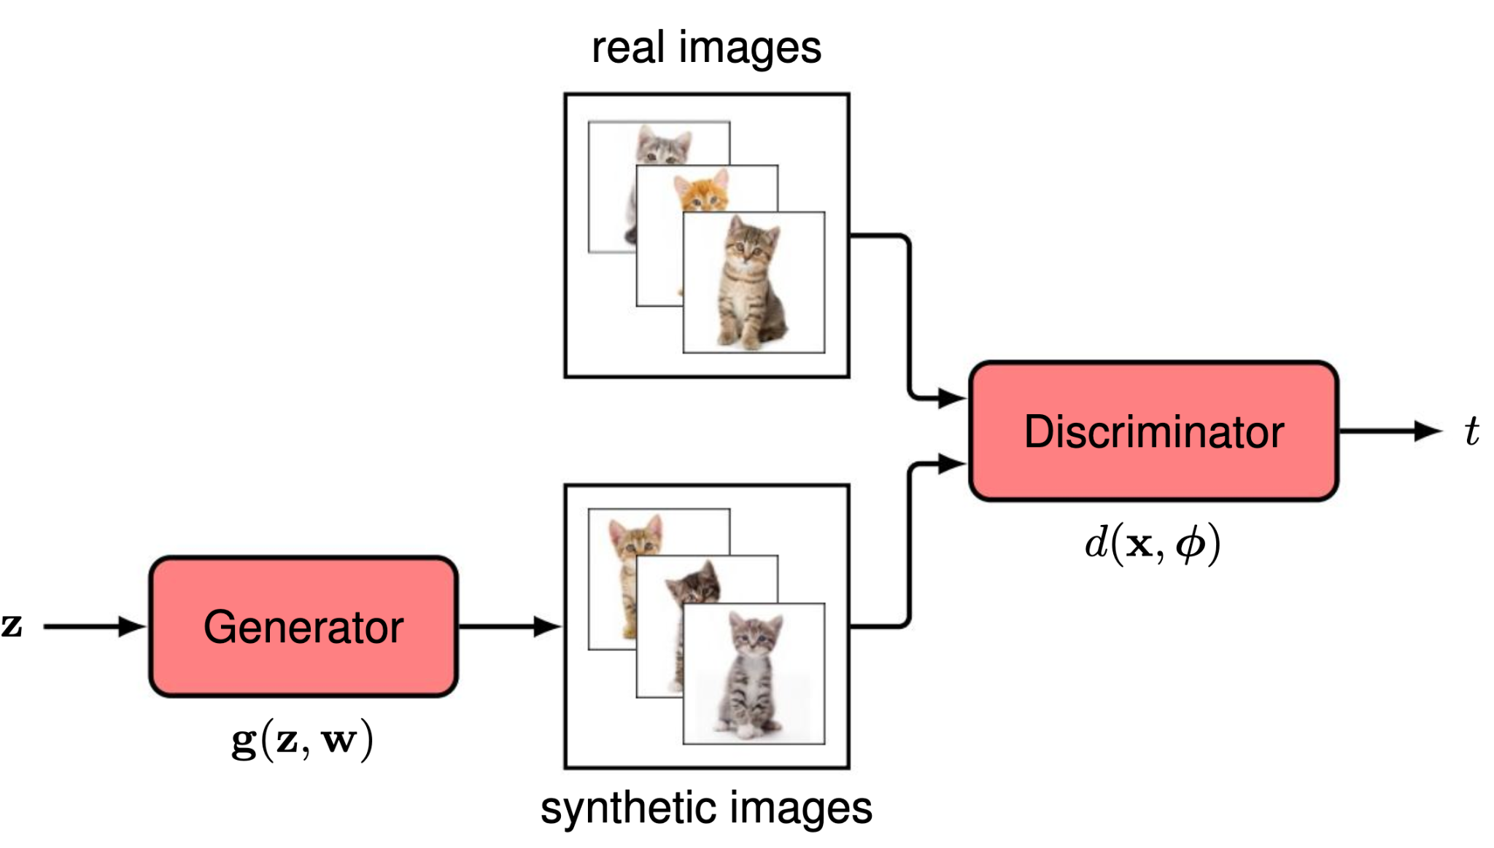
Introduction
Generative Adversarial Networks (GANs) consist of two neural networks working as “adversaries”
Generator (G) - Trained to generate synthetic data from random noise to “fool” the Discriminator.
Discriminator (D) - Trained to distinguish real data from fake (generated) data.
Image Source: Foster, D. (2024). Generative deep learning: Teaching machines to paint, write, compose, and play (2nd ed.). O'Reilly Media.

Slide 7
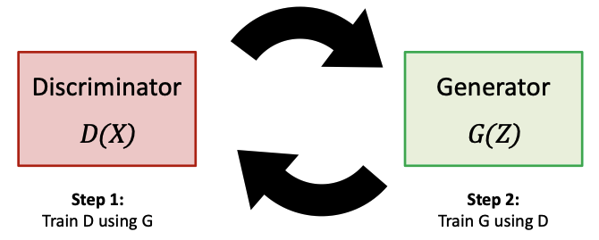
Generative Adversarial Networks
GAN training procedure:
For the number of times you want to update the discriminator’s weights in each batch of real data
Take m real examples and generate m fake examples from the generator (passing random in random inputs from whichever distribution you choose to sample from)
Update ONLY the discriminator’s weights by seeing how well it classifies data as real or fake
Generate m new fake examples, and see how well they fool the discriminator
Update ONLY the generator’s weights from this

Slide 8
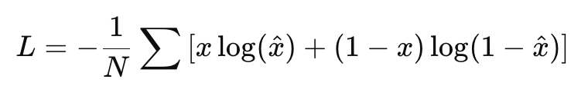
Discriminator Loss Function
What should we use as a loss function for the critic (discriminator)?
Small loss assigned for predicting high score for real images.
Recall the Binary Cross Entropy (BCE) Loss
Discriminator aims to minimize classification loss
We used the BCE for binary classification tasks, where the true value x is either 0 or 1: loss is log(1-x^) if correct value is 0 and log(x^) if it is 1.

Slide 9
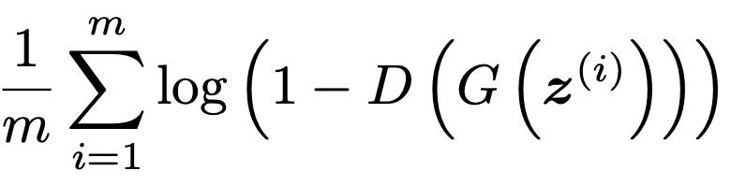
Generator Loss
What should we use as a loss function for the generator?
The discriminator loss is propagated back to the generator
The generator aims to maximize the discriminator loss (we want to “fool” the discriminator)
To evaluate the generator loss we simply pass the generated images to the discriminator and assign a small loss when the discriminator thinks those images are real (i.e. assigns to them the label 1):

Slide 10
Problems with the Vanilla GAN
Regular GANs are hard to train due to the adversarial dynamics between the generator and discriminator:
Sometimes the generator gets no useful feedback (“everything is bad”).
Sometimes the training can collapse. For example, the generator produces limited varieties of outputs that successfully fool the discriminator.
Other training instability (e.g., oscillations and divergence) are common.
Hard to measure convergence or progress.

Slide 11
Problems with the Vanilla GAN
Mitigations:
Use batch normalization to stabilize training and smooth gradient flow
Use LeakyReLU activations in the discriminator to prevent dead neurons
Use Wasserstein loss for more stable gradients
Start with small learning rates (e.g., 1e-4) and monitor both generator and discriminator losses
Visualize generated samples at intervals to detect mode collapse early

Slide 12
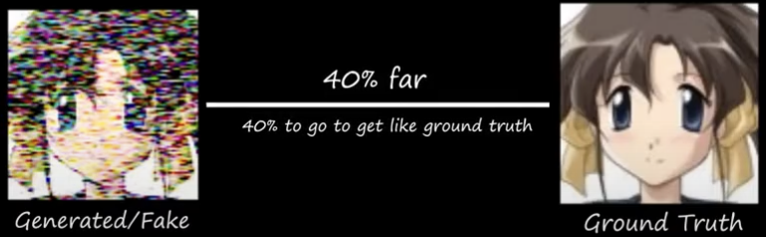
Wasserstein GAN (WGAN)
WGAN uses a new way to measure how close fake and real data are. Instead of “real or fake,” it measures how far apart they are.
Wasserstein Distance: Measures the difference between the real and generated data distribution in terms of how much “work” is required to transform one distribution into the other.

Slide 13
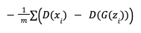
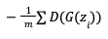
WGAN Loss Functions
Discriminator Loss Function
Change labels to 1 (real image) and -1(fake image) instead of 0 and -1, output range: (-∞, ∞)
Change loss to:
Generator Loss
Loss is small when the discriminator gives high scores to the images generated by the generator.

Slide 14
One last thing…
Allowing scores to range from -∞ to ∞, introduces potential instability to the neural network.
Lipschitz Condition and Gradient Penalty Loss
We need to make sure that if two images are close in terms of pixels, the discriminator will give them similar scores.
Mathematically a function D(x) that satisfies:
|D(x₁) - D(x₂)| < |x₁ - x₂|
is called 1-Lipschitz continuous. This condition can be guaranteed by not allowing the gradient norm to be larger than 1.
A way to address this is to introduce a term in the loss function that penalizes gradient deviating from 1 (this is called a “soft” condition, so it does not guarantee the Lipschitz continuity, but is sufficient in practice).

Slide 15
Training Algorithm
Practical:
Generative Adversarial Networks (GAN)
Iterate k times through the training loop of the critic.
Calculate the critic loss.
Calculate the gradient penalty.
The critic loss function is a weighted sum of the critic loss and the gradient penalty.
Update the weights of the critic.
Calculate the loss for the generator.
Update the weights of the generator.

Slide 16
Evaluation Metrics
Evaluating GAN performance is challenging because there is no explicit likelihood or loss that correlates perfectly with visual or perceptual quality. Some metrics generally used are:
Human Evaluation.
Inception Score (IS): Measure both image quality and diversity. Use a pretrained Inception network to compute conditional label distribution p(y|x) for generated images.
Frechet Inception Distance (FID): Compare feature distributions of real and generated images
Downstream task metrics: e.g., how generated samples affect classifier training.

Slide 17
Variations of GANs

Slide 18
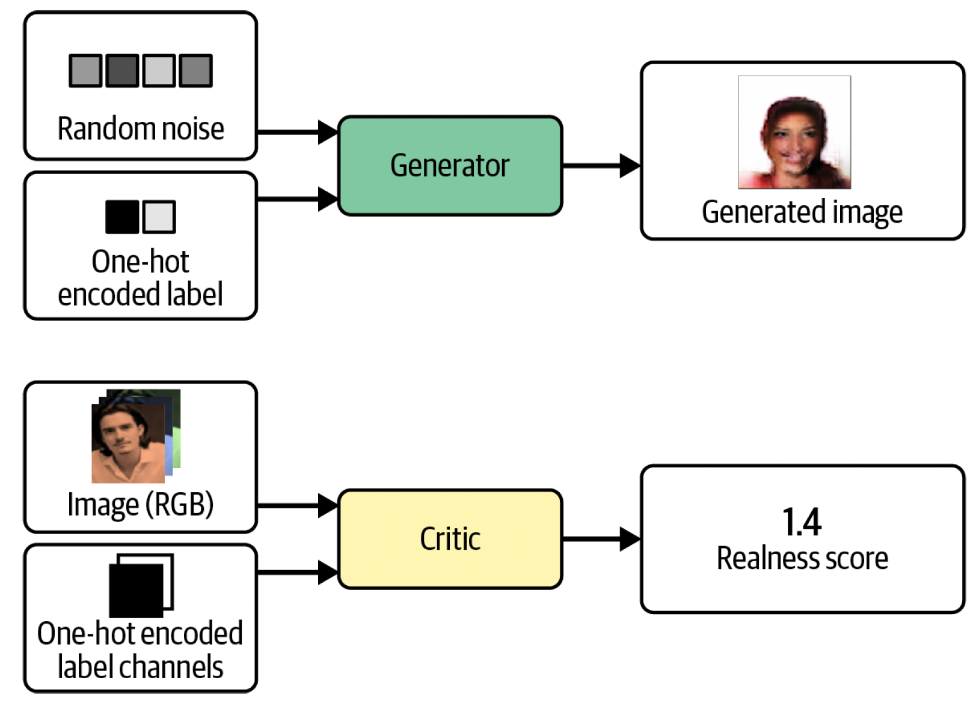
Conditional GAN
Can we get the generator to create images based on a label?
Idea: Add labels to the input of both the generator and the critic:
As input to the generator use both the random latent vectors as before and one-hot encoded label vectors.
As input to the critic transform the one-hot encoded labels to match the format of the input images and use them in addition to the fake/real images.
Image Source: Foster, D. (2024). Generative deep learning: Teaching machines to paint, write, compose, and play (2nd ed.). O'Reilly Media.

Slide 19
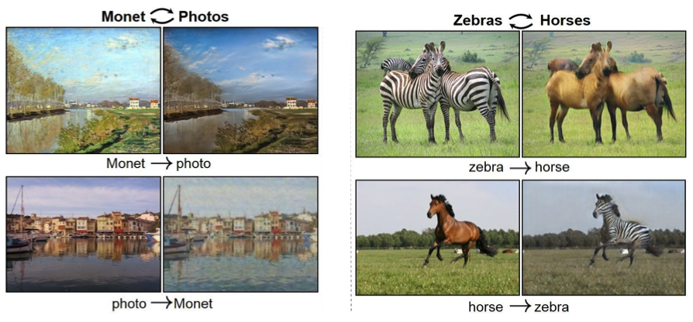
CycleGAN
Can we translate one image to another image?
Idea: Learn to translate between two image domains (X ↔ Y) without paired data by training two generators (X→Y and Y→X) and enforcing cycle consistency so that translating there and back reconstructs the original image.
Image Source: Zhu et al. (2020). “Unpaired image-to-image translation using cycle consistent adversarial networks.

Slide 20
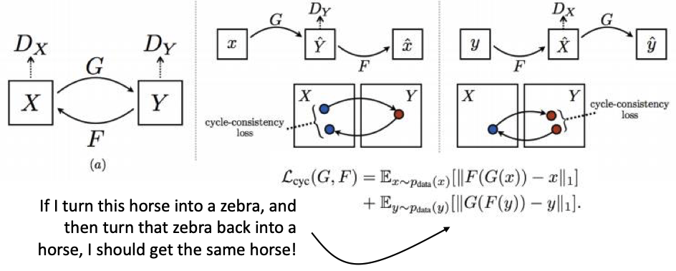
CycleGAN
Can we translate one image to another image?
Two (conditional) generators:
G: turn X into Y (e.g., horse into zebra)
F: turn Y into X (e.g., zebra into horse)
Two discriminators:
D_{x}: is it a realistic horse?
D_{y}: is it a realistic zebra?
Image Source: Zhu et al. (2020). “Unpaired image-to-image translation using cycle consistent adversarial networks.

Slide 21
Implementing GAN in PyTorch
Class Activities: Adding GAN to the helper library

